Slide 1
CSC 102 – LAB EXERCISE I

Slide 2
Instructions
Create a Jupyter Notebook titled “lab-exercise-I.ipynb”
Use Markdown to:
Write the code in a cell block
present yourself: Name, Mat. No and Email
create exercise description
Include pictorial representation
Display output
Commit to your GitHub Repository

Slide 3
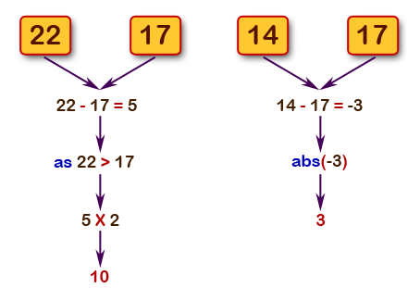
Exercise I
Write a Python program to get the difference between a given number and 17, if the number is greater than 17 return double the absolute difference.
Pictorial Representation

Slide 4
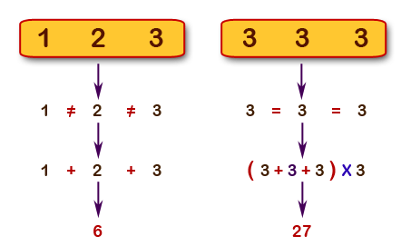
Exercise II
Write a Python program to calculate the sum of three given numbers, if the values are equal then return thrice of their sum.
Pictorial Representation

Slide 5
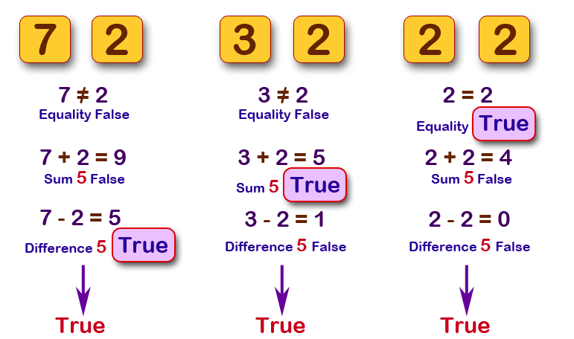
Exercise III
Write a Python program which will return true if the two given integer values are equal or their sum or difference is 5.
Pictorial Representation

Slide 6
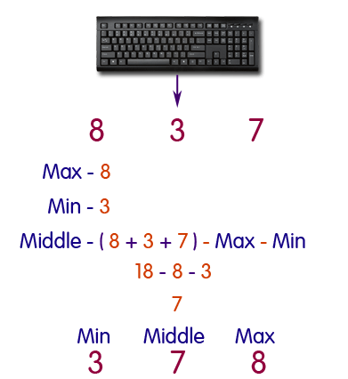
Exercise IV
Write a Python program to sort three integers without using conditional statements and loops.
Pictorial Representation

Slide 7
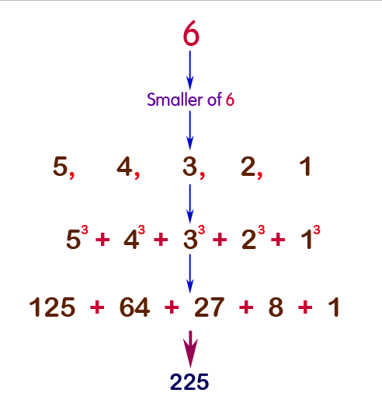
Exercise V
Write a Python function that takes a positive integer and returns the sum of the cube of all the positive integers smaller than the specified number.

